Slide 1
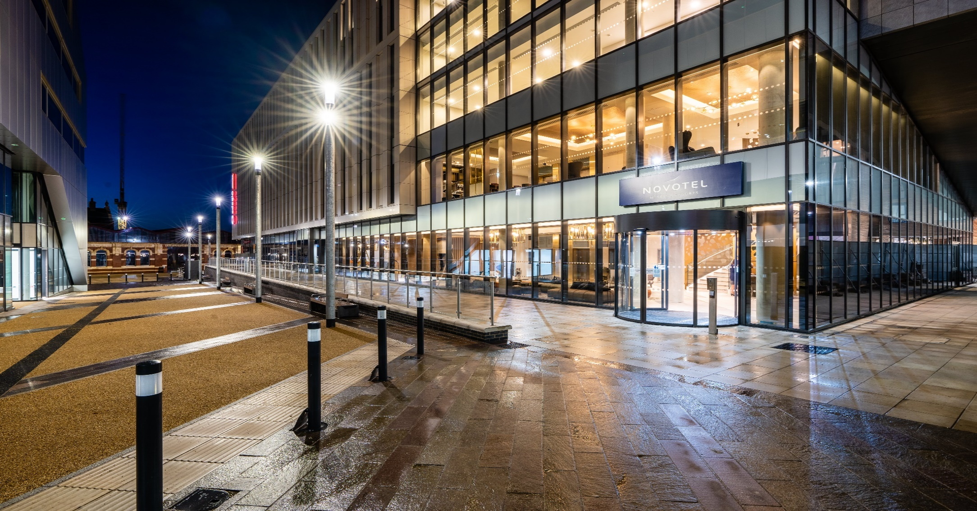


Accor Corporate rate– How to book online guide
Novotel Leicester

Slide 2
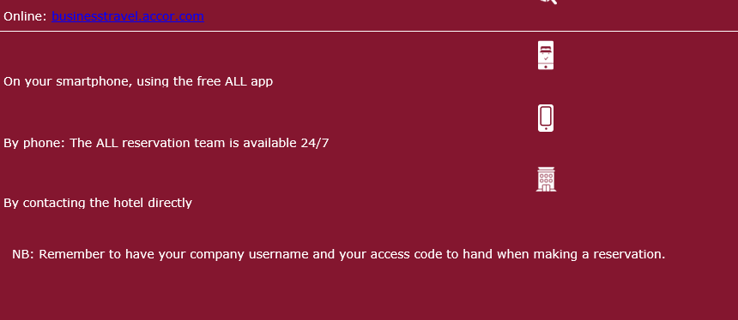
How you can book with us

Slide 3
Your Accor Business offer access codes
FA218GB496
CLIENT / SCP CODE : SCP4605434
YOUR ACCESS CODE : FA218GB496

Slide 4
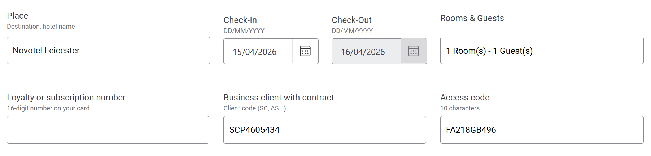
Online booking
Enter dates and location
FASHION-ENTER Business ID

Slide 5
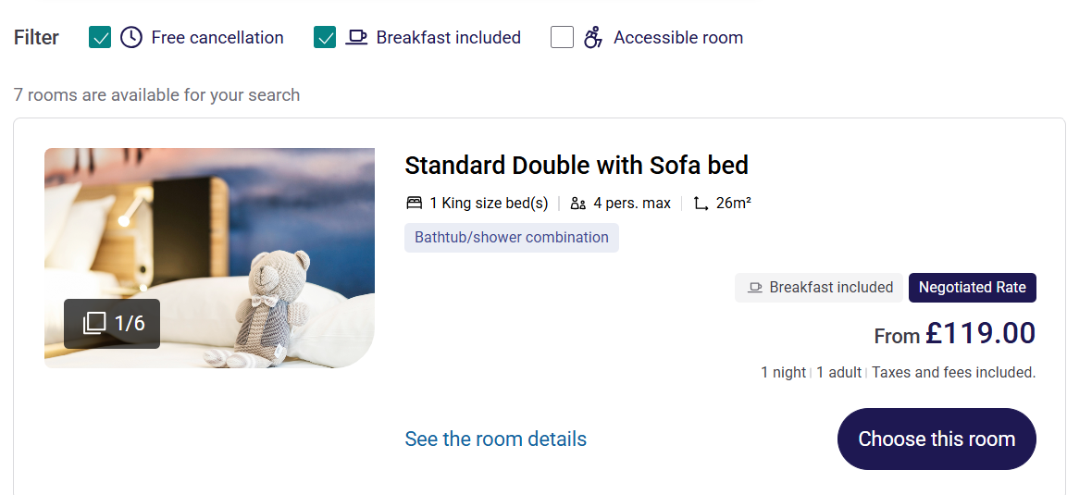
The Negotiated Rate
These filters must be selected
Your negotiated Rate

Slide 6
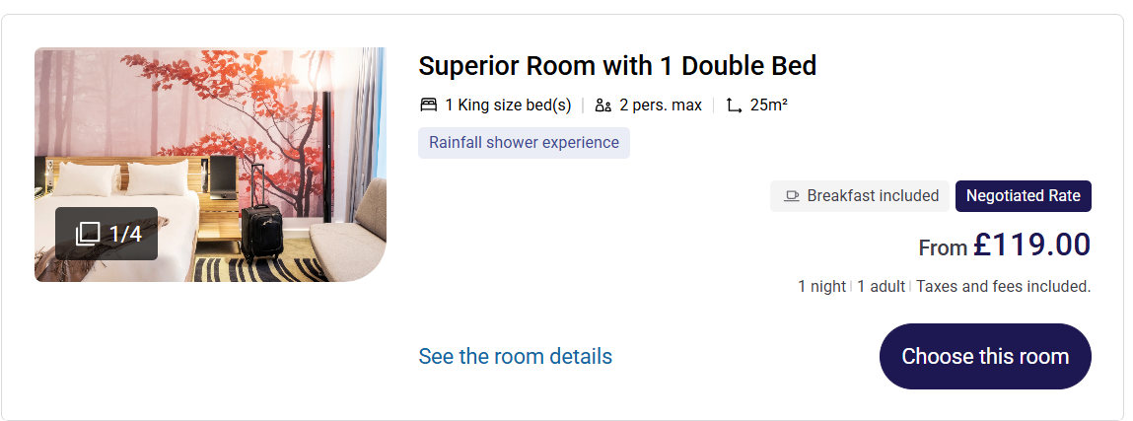
Your Corporate Rate details

Slide 7
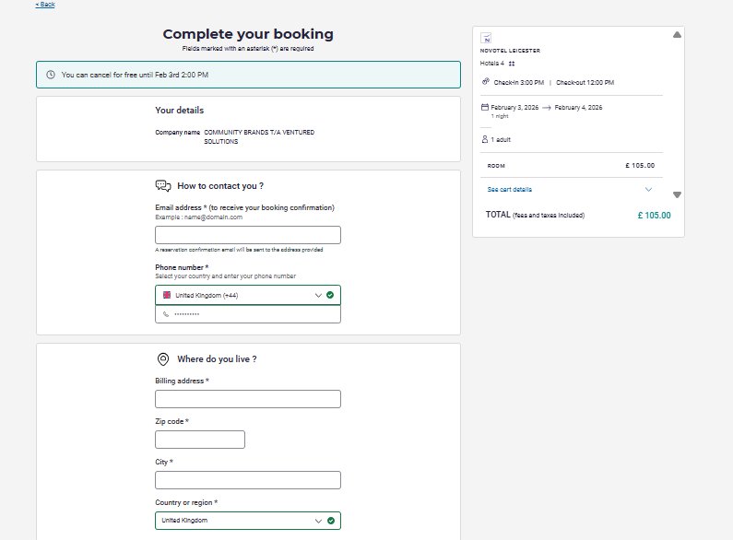
Your Details
Where the confirmation email goes
Company billing address

Slide 8
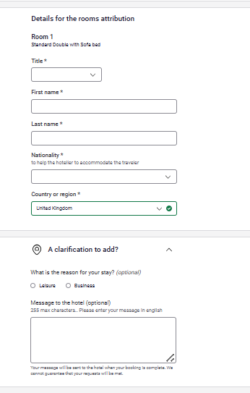
Who is staying details
Extra details – billing instructions, preferences etc.

Slide 9
ENJOY YOUR STAY WITH US

